Slide 1
Project Title: SCORE
(Student Course Recommender)
Dipangkur Sarmah
Satamanu Majhi
Sriraman Rajagopalan

Slide 2
Agenda
Introduction
Project Proposal
System flow
Architecture
Q/A

Slide 3
Introduction
After 10th , what next ?

Slide 4
Introduction - Survey
Most people – about 80% are dissatisfied with their jobs -- Deloitte’s Shift Index survey
About 85% graduates in India are not employable -- IndiaSkills, a skills training company
India has forgotten all about "scientific temper" – a very serious issue
“Become an engineer, then decide what you want to do in life”
Recommended websites for reading
http://profit.ndtv.com/news/economy/article-how-coaching-classes-are-widening-the-class-divide-in-india-310625 -- NDTV
https://www.quora.com/What-are-some-bitter-truths-about-engineering-in-India –Quora

Slide 5
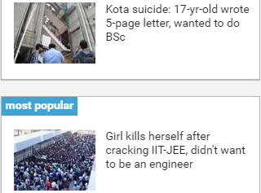
Introduction - Reasons
Students make wrong career choices because:
Confusion
Peer pressure
Choosing a career to fulfill parent’s wish
Choosing a stream without retrospection
Choosing a stream without any research
Ignoring results of aptitude tests
No goal in mind
Choosing a career having a role-model in mind
Choosing a career that gives maximum advantage
Experts say that most of the suicides are due to
fear of failure
burden of expectations from family.
Children need to be told failed attempt
at JEE is okay: Counsellors

Slide 6
Project proposal - I
A recommendation model for students for Grade 10 / immediate Grade 10 pass out
Recommend choices of course(s) will be based on student data
Salient attributes for this recommendation will be (not limited to) :
    personal interest
    preferences
    socio-economic background
    geographical location
    parent’s education
Streams to recommend
    Sciences
    Commerce
    Arts & Humanities
    Polytechnic

Slide 7
Project proposal - II
Data
Data will be classified into the following 3 sections
  Pre-defined data – institution, eligibility criteria etc
  Real-time data – Students (forms, write-ups, questionnaire etc)
  Historical data – Success stories
Static data. No real-time data processing capability now
CSV / TXT data format
Data source
  Schools
  Internet

Slide 8

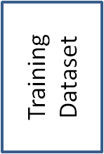
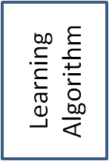
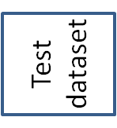
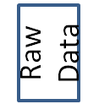
System flow
Dimension reduction
Sampling
Feature Selection
Labels
Final Model
Data
Labels
Pre-processing
Learning
Evaluation
Prediction
Model Selection
Cross Validation
Optimization

Slide 9
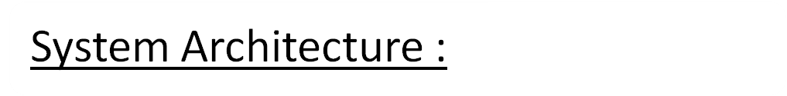
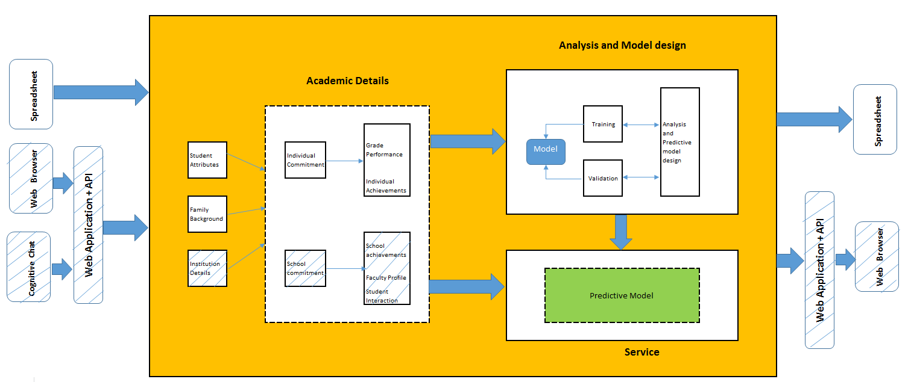
Solution architecture

Slide 10
Q/A ?
Thank you

